Slide 1
THE PREDICT FUNCTION
TEAM 12
Cory Ryder, Layla Liang,
Megan Brunick & Tahir Shehzad

Slide 2
AGENDA
01
02
03
CONCEPTUAL
OVERVIEW
APPLIED
EXERCISE
POLL
QUESTIONS
Predict Function
Exercise 6.9
(Page 286)

Slide 3
WRITE A PREDICTION EQUATION
ŷ =
b₀ +
b₁X₁ + b₂X₂ + …+ b_{p}X_{p}
+ ɛ
Where p is the number of independent variables

Slide 4
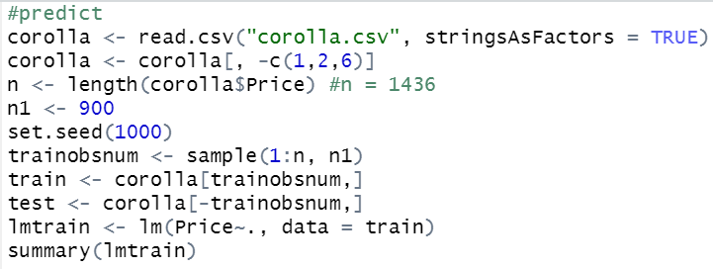
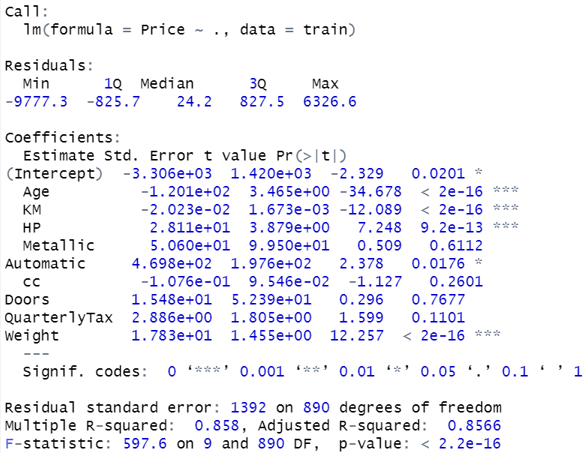
PREDICT FUNCTION REVIEW ML1

Slide 5
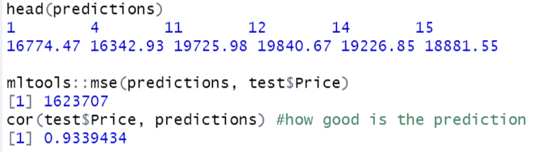
LEAST SQUARES MODEL PREDICTIONS
function:
predict(object, newdata)
predictions <-
predict( )
lmtrain , newdata = test
IN R:

Slide 6
PREDICT FUNCTION USES
Alternative methods to least squares have better prediction accuracy
Regsubsets in R (leaps package) performs model selection
Best subset, forward, and backward
Does not have a built-in predict function
Create our own function to make predictions and do cross validation

Slide 7
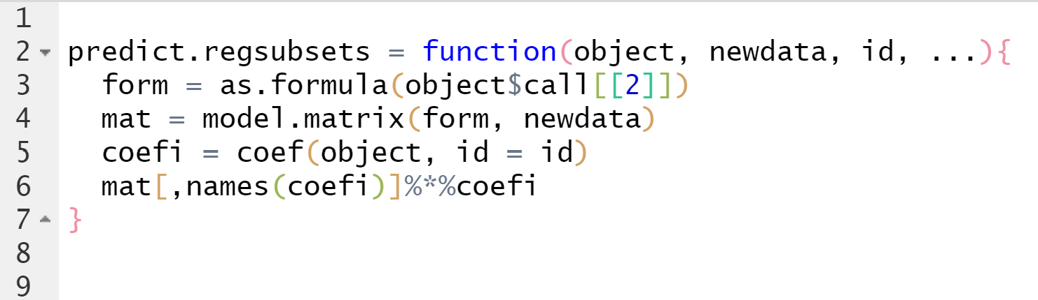
FUNCTION STRUCTURE
predict.regsubsets = function(object, newdata, id, ...){
form = as.formula(object$call[[2]])
mat = model.matrix(form, newdata)
coefi = coef(object, id = id)
mat[,names(coefi)]%*%coefi
}
IN R:

Slide 8
BREAKING IT DOWN…
FUNCTION PARAMETERS
object: regsubsets models created using training data set
newdata: test data set
id: ‘i’ number of features in model
predict.regsubsets = function(object, newdata, id, ...){
form = as.formula(object$call[[2]])
mat = model.matrix(form, newdata)
coefi = coef(object, id = id)
mat[,names(coefi)]%*%coefi
}

Slide 9
BREAKING IT DOWN…
FORM
Calls to regsubsets()
Takes the formula from the ‘object’ and saves it to a variable
MAT
Builds an n x p matrix with data for every row and feature - removes response variable
Creates dummy variables for all categorical variables
COEFI
Extracts coefficients for the best p-variable model
When p = 2, it saves coefficients of the two features that result in the best model
‘id = id’ statement indicates the ‘i’th model
Corresponds to the function argument
predict.regsubsets = function(object, newdata, id, ...){
form = as.formula(object$call[[2]])
mat = model.matrix(form, newdata)
coefi = coef(object, id = id)
mat[,names(coefi)]%*%coefi
}

Slide 10
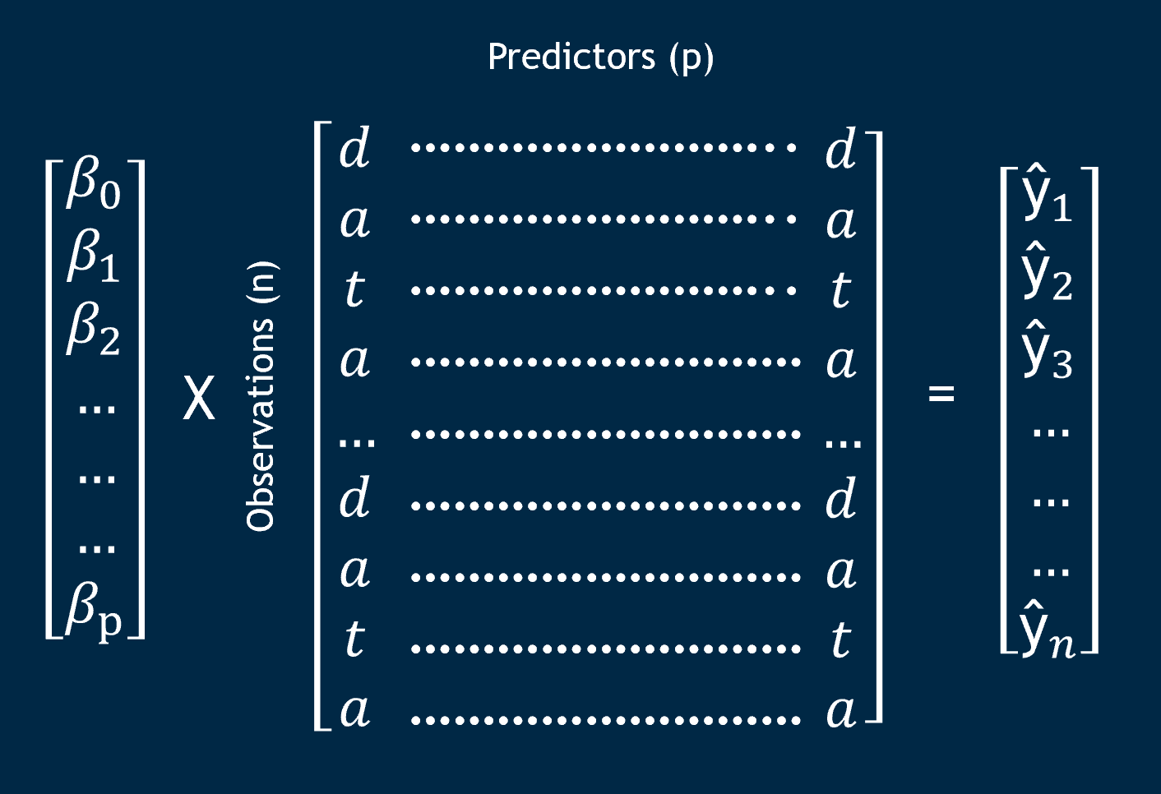
MATRIX MULTIPLICATION
mat[,names(coefi)] %*% coefi
Complex calculation in one line of code
Multiplies values of features in the matrix with coefficients of the features to make predictions
Number of features in object is not fixed
predict.regsubsets = function(object, newdata, id, ...){
form = as.formula(object$call[[2]])
mat = model.matrix(form, newdata)
coefi = coef(object, id = id)
mat[,names(coefi)]%*%coefi
}

Slide 11
EXERCISE 6.9
Least squares: minimizes RSS
Ridge: minimizes RSS and directs coefficients toward zero
Uses tuning parameter (λ)
Lasso: minimizes RSS and directs coefficients toward zero, forcing some to actually be zero (feature selection)
Uses tuning parameter (λ)
PCR: reduces model to a set of principal components that capture the most variation in the data (unsupervised learning)
Uses MSE to decide best number of components
PLS: identifies linear combinations that explain the most variation in the predictors AND the response (supervised learning)
Uses cross validation to decide number of components

Slide 12
PREDICTION RESULTS
MSEs are relatively close, ranging from 890,000 to 1.6 million
Lasso and ridge are similar
PCR performed the worst
Ridge regression has smallest test error → best model for college data
R^2 = .9705
MODEL | MSE
LEAST SQUARES | 1,050,587
RIDGE | 892,906
LASSO | 987,913
PCR | 1,682,909
PLS | 1,011,426

Slide 13
POLL EVERYWHERE
pollev.com/meganbrunick916

Slide 14
QUESTIONS

